Slide 1

VIETNAM NATIONAL UNIVERSITY – HO CHI MINH CITY
UNIVERSITY OF INFORMATION TECHNOLOGY
DS307
SOCIAL MEDIA ANALYSIS
Faculty of Information Science and Engineering
University of Information Technology, VNU-HCM
UIT, VNU-HCM
Social Media Analysis

Slide 2
This Course’s Contents
  Document Retrieval
UIT, VNU-HCM
Social Media Analysis

Slide 3
Document Retrieval
Retrieve documents with content that is relevant to a user’s information need
Document set is fixed (size can vary from 10s of documents to billions)
Information need is not fixed (ad-hoc retrieval)
Goal:
  Documents relevant to query should be returned
  Documents not relevant to query should not be returned
UIT, VNU-HCM
Social Media Analysis

Slide 4
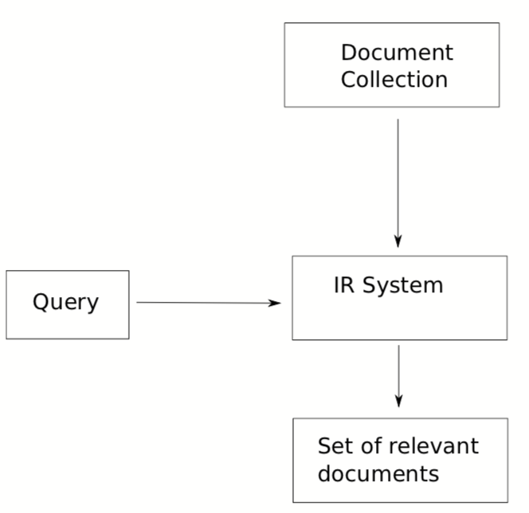
Document Retrieval Architecture
UIT, VNU-HCM
Social Media Analysis

Slide 5
Documents as vectors
Sec. 6.3
So we have a |V|-dimensional vector space
Terms are axes of the space
Documents are points or vectors in this space
Very high-dimensional: tens of millions of dimensions when you apply this to a web search engine
These are very sparse vectors - most entries are zero.
UIT, VNU-HCM
Social Media Analysis

Slide 6
Queries as vectors
Sec. 6.3
Key idea 1: Do the same for queries: represent them as vectors in the space
Key idea 2: Rank documents according to their proximity to the query in this space
proximity = similarity of vectors
proximity ≈ inverse of distance
UIT, VNU-HCM
Social Media Analysis

Slide 7
Formalizing vector space proximity
Sec. 6.3
First cut: distance between two points
  ( = distance between the end points of the two vectors)
Euclidean distance?
Euclidean distance is a bad idea . . .
. . . because Euclidean distance is large for vectors of different lengths.
UIT, VNU-HCM
Social Media Analysis

Slide 8

Why distance is a bad idea
Sec. 6.3
The Euclidean distance between q
and d₂ is large even though the
distribution of terms in the query q and the distribution of
terms in the document d₂ are very similar.
UIT, VNU-HCM
Social Media Analysis

Slide 9
Use angle instead of distance
Sec. 6.3
The Euclidean distance between the two documents can be quite large
The angle between the two documents is 0, corresponding to maximal similarity.
Key idea: Rank documents according to angle with query.
UIT, VNU-HCM
Social Media Analysis

Slide 10

cosine(query,document)
Sec. 6.3
Dot product
Unit vectors
q_{i} is the weight of term i in the query
d_{i} is the weight of term i in the document
cos(q,d) is the cosine similarity of q and d … or,
equivalently, the cosine of the angle between q and d.
UIT, VNU-HCM
Social Media Analysis
Notes:
See Law of Cosines (Cosine Rule) wikipedia page

Slide 11
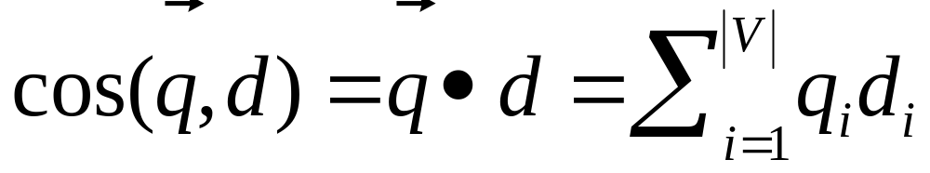
Cosine for length-normalized vectors
For length-normalized vectors, cosine similarity is simply the dot product (or scalar product):
for q, d length-normalized.
UIT, VNU-HCM
Social Media Analysis

Slide 12

Cosine similarity illustrated
UIT, VNU-HCM
Social Media Analysis

Slide 13
Cosine similarity amongst 3 documents
Sec. 6.3
How similar are
the novels
SaS: Sense and
Sensibility
PaP: Pride and
Prejudice, and
WH: Wuthering
Heights?
term | SaS | PaP | WH
affection | 115 | 58 | 20
jealous | 10 | 7 | 11
gossip | 2 | 0 | 6
wuthering | 0 | 0 | 38
Term frequencies (counts)
Note: To simplify this example, we don’t do idf weighting.
UIT, VNU-HCM
Social Media Analysis

Slide 14
3 documents example contd.
Sec. 6.3
Log frequency weighting
After length normalization
term | SaS | PaP | WH
affection | 3.06 | 2.76 | 2.30
jealous | 2.00 | 1.85 | 2.04
gossip | 1.30 | 0 | 1.78
wuthering | 0 | 0 | 2.58
term | SaS | PaP | WH
affection | 0.789 | 0.832 | 0.524
jealous | 0.515 | 0.555 | 0.465
gossip | 0.335 | 0 | 0.405
wuthering | 0 | 0 | 0.588
UIT, VNU-HCM
Social Media Analysis
Notes:
1 + log(115) = 3.06
3.06/sqrt(sqr(3.06) + sqr(2.00) + sqr(1.30)) = 0.789

Slide 15

Computing cosine scores
Sec. 6.3
UIT, VNU-HCM
Social Media Analysis

Slide 16
Computing cosine scores
Sec. 6.4
Previous algorithm scores term-at-a-time (TAAT)
Algorithm can be adapted to scoring document-at-a-time (DAAT)
Storing w_{t,d} in each posting could be expensive
  …because we’d have to store a floating point number
  For tf-idf scoring, it suffices to store tf_{t,d} in the posting and idf_{t} in the head of the postings list
Extracting the top K items can be done with a priority queue (e.g., a heap)
UIT, VNU-HCM
Social Media Analysis

Slide 17

tf-idf weighting has many variants
Sec. 6.4
UIT, VNU-HCM
Social Media Analysis
Notes:
n default is just term frequency
ltc is best known form of weighting

Slide 18
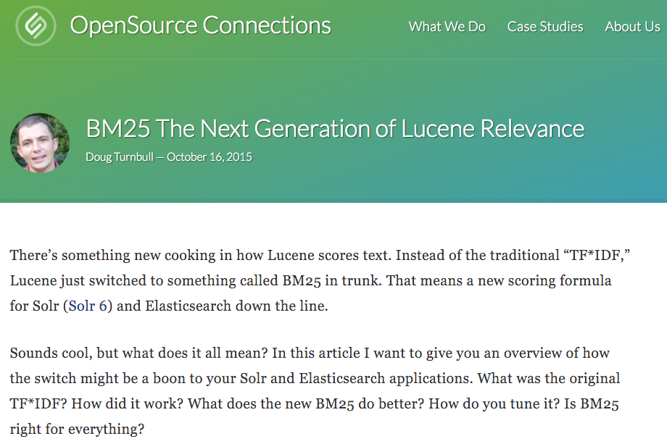
BM25
UIT, VNU-HCM
Social Media Analysis
Notes:
Lucene 6.0 released 8 April 2016 has this!

Slide 19
Okapi BM25 [Robertson et al. 1994, TREC City U.]
BM25 “Best Match 25” (they had a bunch of tries!)
  Developed in the context of the Okapi system
  Started to be increasingly adopted by other teams during the TREC competitions
  It works well
Goal: be sensitive to term frequency and document length while not adding too many parameters
  (Robertson and Zaragoza 2009; Spärck Jones et al. 2000)
UIT, VNU-HCM
Social Media Analysis

Slide 20
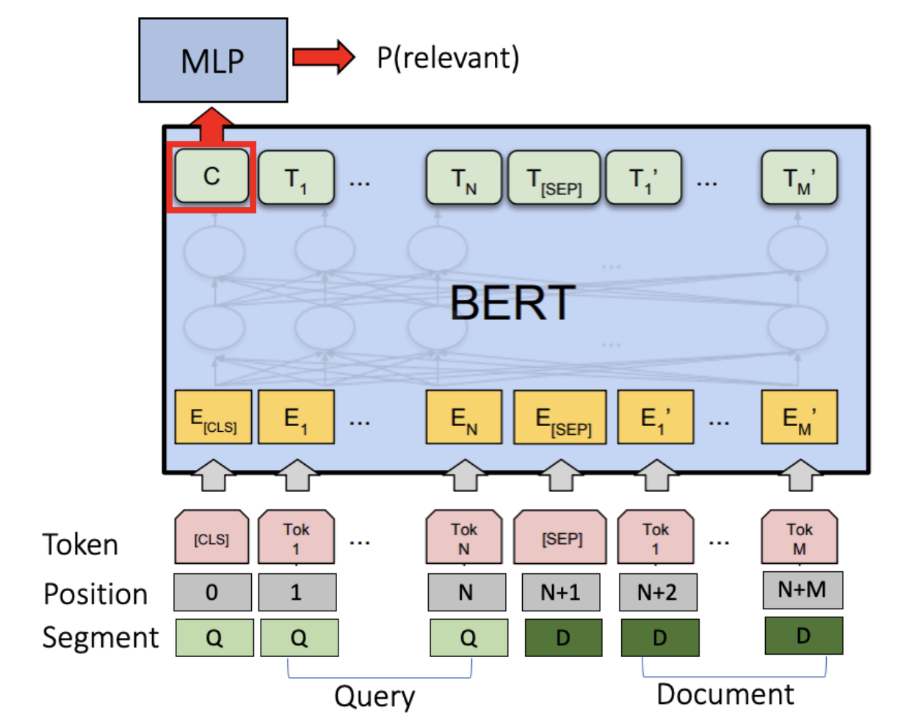
IR with Contextual Neural Language Modeling
Dai, Zhuyun, and Jamie Callan. "Deeper text understanding for IR with contextual neural language modeling" Proceedings of the 42nd International ACM SIGIR Conference on Research and Development in Information Retrieval. 2019.
UIT, VNU-HCM
Social Media Analysis

Slide 21
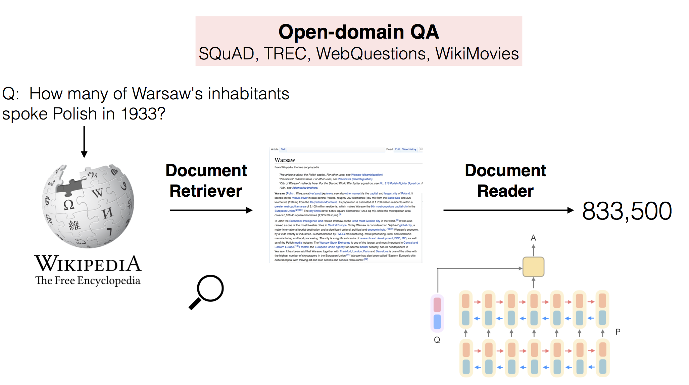
Hệ thống hỏi đáp tự động
Document Retriever: TF-IDF
Chen, Danqi, et al. "Reading Wikipedia to Answer Open-Domain Questions." ACL. 2017.
UIT, VNU-HCM
Social Media Analysis

Slide 22
Summary – vector space ranking
Represent the query as a weighted tf-idf vector
Represent each document as a weighted tf-idf vector
Other modern IR models: BM25, BERT, …
Compute the cosine similarity score for the query vector and each document vector
Rank documents with respect to the query by score
Return the top K (e.g., K = 10) to the user
UIT, VNU-HCM
Social Media Analysis

Slide 23
Q&A
UIT, VNU-HCM
Social Media Analysis

Slide 24
  Thank you!
UIT, VNU-HCM
Social Media Analysis

